Slide 1

SQL - CRUD
SQL - CRUD
CRUD (Create, Read, Update, Delete)
Create: Using CREATE TABLE
Read: Using SELECT (we already know this!)
Update: Using ALTER TABLE
Delete: Using DROP TABLE

Slide 2
Contents
CRUD (Create, Read, Update, Delete)
Create: Using CREATE TABLE
Read: Using SELECT (we already know this!)
Update: Using ALTER TABLE
Delete: Using DROP TABLE

Slide 3
Creating Tables
We can create a new blank table or create a new one from existing tables using SELECT
Blank tables can be created using the CREATE TABLE statement. The syntax is as follows:
CREATE TABLE {table_name} (
{column_name_1} {data_type_1} {column_constraint_1},
{column_name_2} {data_type_2} {column_constraint_2},
…
{column_name_last} {data_type_last} {column_constraint_last},
{additional_contraints}
);

Slide 4
Creating Tables
{table_name} is the name of the table
{column_name} is the name of the column
{data_type} is the data type of the column:
INT: −2,147,483,648 to 2,147,483,647
text: Holds a string with a maximum length of 65,535 bytes
CHAR(size): A fixed length string
VARCHAR(size): A fixed length string
DATE: YYYY-MM-DD
To see more data types, go to this link

Slide 5
Creating Tables - Constraints
{column_constraint} one or more optional keywords giving special properties to the column:
CHECK: Ensure that a boolean condition is met
NOT_NULL: Ensure that no row has a NULL value
UNIQUE: Ensure that all values are different
PRIMARY KEY: Combination of NOT_NULL and UNIQUE. Helps the RDBSM finding the key quicker
For more constraints, visit this link
Remember that the table starts blank, and then we populate data. The added data will be limited by the data type constraints we set now.

Slide 6
Constraints - CHECK
CHECK: Ensures that a boolean condition is met
CREATE TABLE movies (
title VARCHAR(30),
release_date DATE,
minutes INT CHECK (minutes > 0)
);

Slide 7
Constraints - CHECK
CONSTRAINT: You can give a name to a condition, so error messages are descriptive
CREATE TABLE movies (
title VARCHAR(30),
release_date DATE,
minutes INT CONSTRAINT positive CHECK (minutes > 0)
);

Slide 8
Constraints - CHECK
We can also add constraints between columns
CREATE TABLE movies (
title VARCHAR(30),
release_date DATE,
premier_access DATE,
minutes INT CONSTRAINT positive CHECK (minutes > 0)
CONSTRAINT valid_premier CHECK (release_date > premier_access)
);

Slide 9
Constraints - NOT NULL
NOT_NULL: Ensures that no row has a NULL value
CREATE TABLE movies (
title VARCHAR(30) NOT NULL,
release_date DATE NOT NULL,
premier_access DATE,
minutes INT NOT NULL CHECK (minutes > 0)
CONSTRAINT valid_premier CHECK (release_date > premier_access)
);

Slide 10
Constraints - UNIQUE
UNIQUE: Ensure that all values are different
CREATE TABLE movies (
title VARCHAR(30) UNIQUE NOT NULL,
release_date DATE NOT NULL,
premier_access DATE,
minutes INT CONSTRAINT positive CHECK (minutes > 0)
CONSTRAINT valid_premier CHECK (release_date > premier_access)
);

Slide 11
Constraints - PRIMARY KEY
PRIMARY KEY: a column, or group of columns, can be used as a unique identifier for rows in the table. This requires that the values be both unique and not null
CREATE TABLE movies (
title VARCHAR(30) PRIMARY KEY,
release_date DATE NOT NULL,
premier_access DATE,
minutes INT CONSTRAINT positive CHECK (minutes > 0),
CONSTRAINT valid_premier CHECK (release_date > premier_access)
);

Slide 12
Creating Tables from SELECT
When creating a table, we could use an existing one by making a SELECT query on it. The syntax is:
CREATE TABLE {table_name} AS (
{SELECT_QUERY}
);
CREATE TABLE actor_short AS (
SELECT * FROM actor
LIMIT 10
);

Slide 13
Updating Tables
When updating a table, you can add or drop columns, add rows, or change data points.
Manipulating columns is done using the ALTER TABLE statement. The syntax is as follows:
ALTER TABLE {table_name}
ADD COLUMN {column name} {data_type} {constraint};
ALTER TABLE {table_name}
DROP COLUMN {column name};

Slide 14
Adding Rows
We can add rows using the INSERT INTO statement. The syntax is:
INSERT INTO {table_name} ({column_1}, {column_2}, …)
VALUES ({column_1}, {column_2}, …);
INSERT INTO {table_name} ({column_1}, {column_2}, …)
{SELECT QUERY};
INSERT INTO actor_short
SELECT * FROM actor
WHERE first_name LIKE '%EN';

Slide 15
Updating Rows
We can update rows using the UPDATE statement. We need to tell the query what column to SET given a WHERE condition:
UPDATE {table_name}
SET {column_1} = {column_value_1}
{column_2} = {column_value_2}
…
WHERE {condition}
UPDATE actor_short
SET last_name = ‘AFFLECK’
WHERE first_name = ‘BEN’

Slide 16
Updating Rows
You can use the same statement to delete values in a row
UPDATE {table_name}
SET {column_1} = NULL
{column_2} = NULL
…
WHERE {condition}

Slide 17
Deleting Rows
You can delete rows, the content of a table, or a whole table
The syntax for deleting a row is:
DELETE FROM {table_name}
WHERE {conditional};
DELETE FROM actor_short
WHERE actor_id = 83;

Slide 18
Deleting
The syntax for deleting the content of the table is:
DELETE FROM {table name}
DELETE FROM actor_short
The syntax for deleting the whole table is:
DROP TABLE {table name}
DROP TABLE actor_short

Slide 19
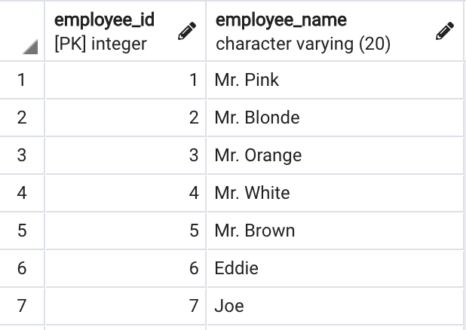
Practical
Go to pgAdmin4 and create a new Database
Create a table named employee_details with the following values
Take into account the constraints

Slide 20
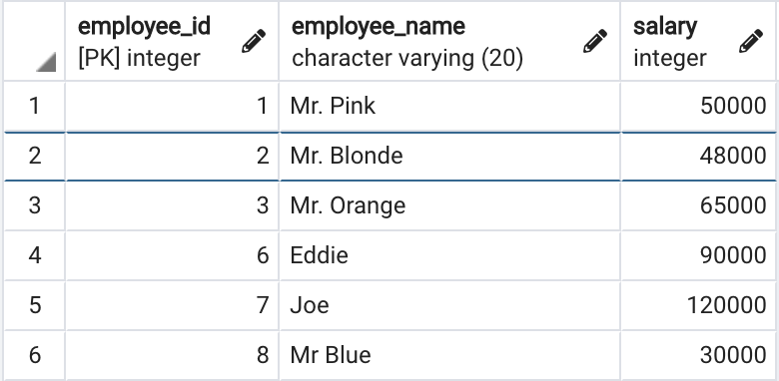
Practical
Create a table named employee_salary with the following values
Take into account the constraints
Don’t delete the database! We will use it in the next lesson

